Slide 1
Baseband Signal Transmission
II

Slide 2
Baseband signal transmission
Multiamplitude signal transmission
Multidimensional signal transmission
Digital transmission through bandlimited channels

Slide 3
Multiamplitude signal transmission
In this section, we use signal waveforms that take on multiple amplitude levels. Thus, we can transmit multiple bits per signal waveform.
The signal waveforms with four amplitude levels (4PAM):
Each 4PAM signal can be used to transmit 2 bits:
Symbol interval and bit interval:

Slide 4
Multiamplitude signal transmission
Notes:
卷积表达式，

Slide 5
Multiamplitude signal transmission
Consequently, after passing through AWGN channel, the received signal is:
Optimum receiver: signal correlator or matched filter
The output of correlator:
where n is Gaussian with mean of 0 and variance of
Notes:
卷积表达式，

Slide 6
Multiamplitude signal transmission
Detector:
The detector observes the correlator or matched filter output and decides which of the four PAM signals was transmitted in the current signal interval.
Optimum detector: (minimal Euclidean distance)
The probability of error:
The average transmitted signal energy per symbol:
Notes:
卷积表达式，

Slide 7
Multiamplitude signal transmission
P5.8: Monte Carlo simulation of the 4-PAM system
Notes:
卷积表达式，

Slide 8
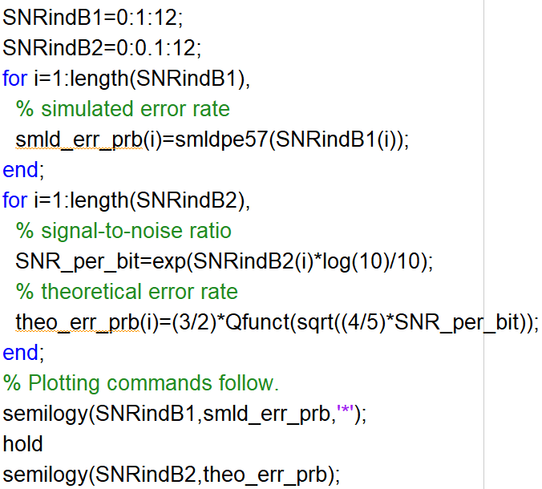
Multiamplitude signal transmission
Main script:
Notes:
卷积表达式，

Slide 9
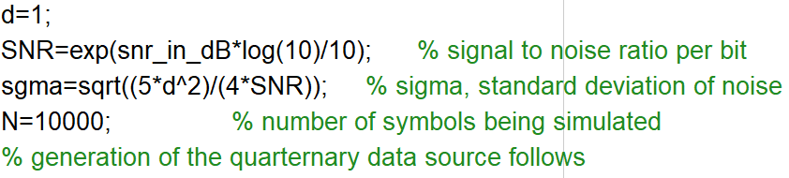
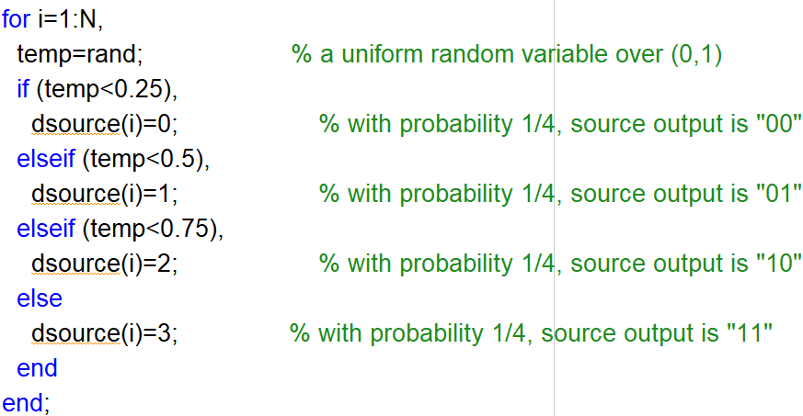
Multiamplitude signal transmission
Noise variance:
Function:smldpe57()
SNR: E_{b}/N₀
Notes:
卷积表达式，

Slide 10
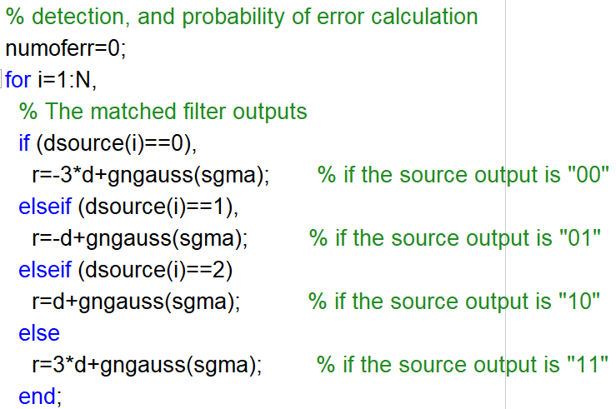
Multiamplitude signal transmission
Function:smldpe57()
Notes:
卷积表达式，

Slide 11
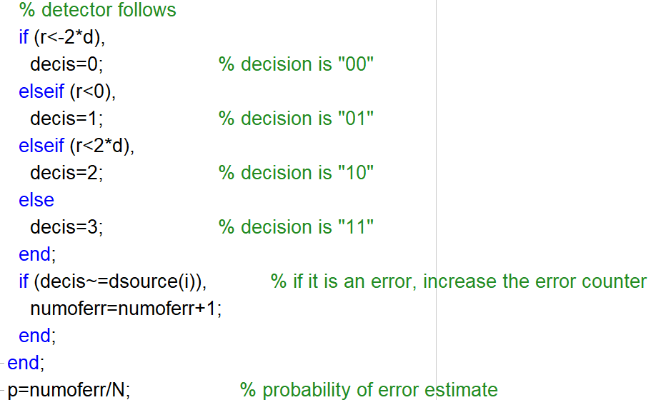
Multiamplitude signal transmission
Function:smldpe57()
Notes:
卷积表达式，

Slide 12
Multidimensional signals
PAM is one dimensional signal.
We construct a set of M=2^{k} waveforms s_{i}(t), which have the properties of (a) mutual orthogonality (b) equal energy:
^{For M=4:}

Slide 13
Multidimensional signals
Notes:
卷积表达式，

Slide 14
Multidimensional signals
Consequently, after passing through AWGN channel, the received signal is:
Optimum receiver: signal correlator or matched filter
Notes:
卷积表达式，

Slide 15
Multidimensional signals
The output of correlator:
Suppose s₀(t) is transmitted, then
where n_{i} is independent Gaussian with mean of 0 and variance of
Notes:
卷积表达式，

Slide 16
Multidimensional signals
Detector:
The optimum detector observes the M outputs r₁,r₂,…,r_{M} and selects the signal corresponding to the largest output.
The probability of symbol error:
The probability of bit error:
Notes:
卷积表达式，

Slide 17
Multidimensional signals
P5.10: Monte Carlo simulation of the orthogonal signal transmission system with M=4
Notes:
卷积表达式，

Slide 18
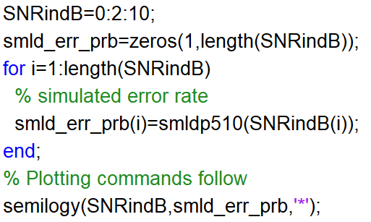
Multidimensional signals
Main script:
Notes:
卷积表达式，

Slide 19
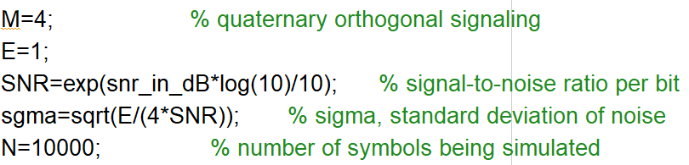
Multidimensional signals
Function:smldpe510()
Noise variance:
SNR: E_{b}/N₀
Notes:
卷积表达式，

Slide 20
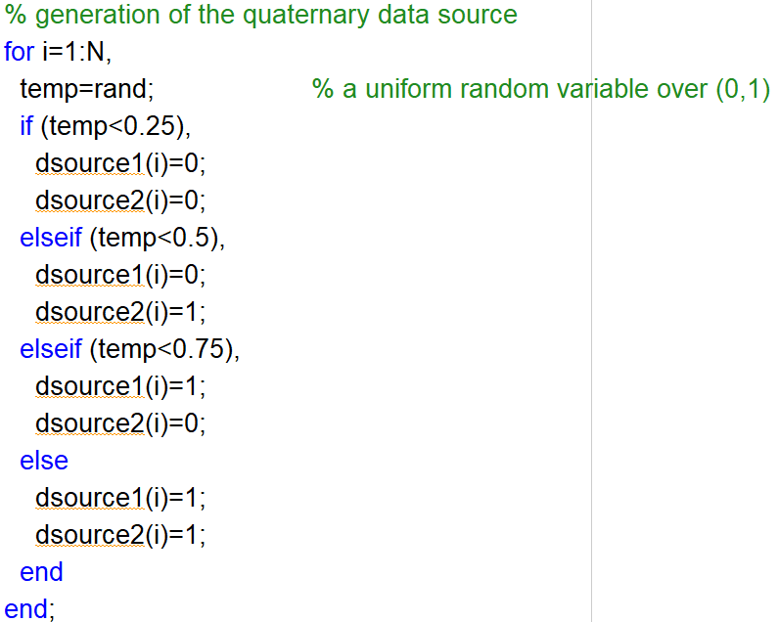
Multidimensional signals
Function:smldpe510()
Notes:
卷积表达式，

Slide 21
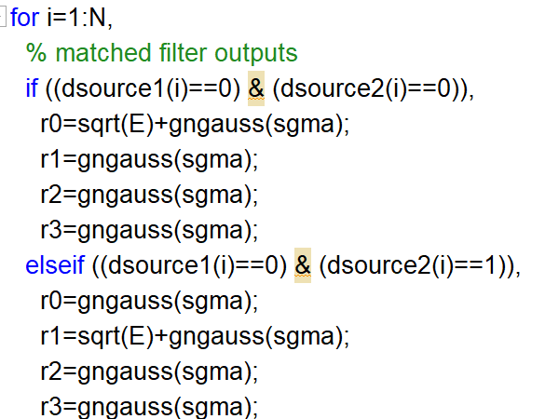
Multidimensional signals
Function:smldpe510()
Notes:
卷积表达式，

Slide 22
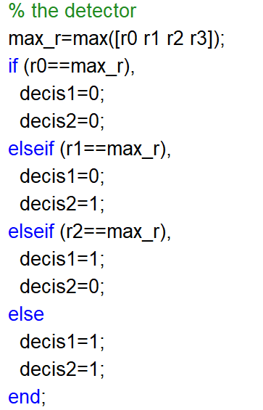
Multidimensional signals
Function:smldpe510()
Notes:
卷积表达式，

Slide 23
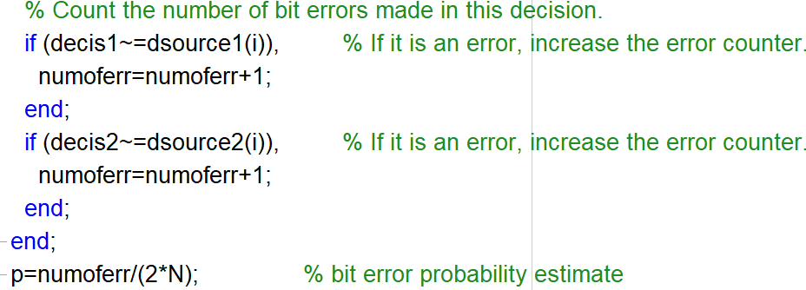
Multidimensional signals
Function:smldpe510()
Notes:
卷积表达式，

Slide 24
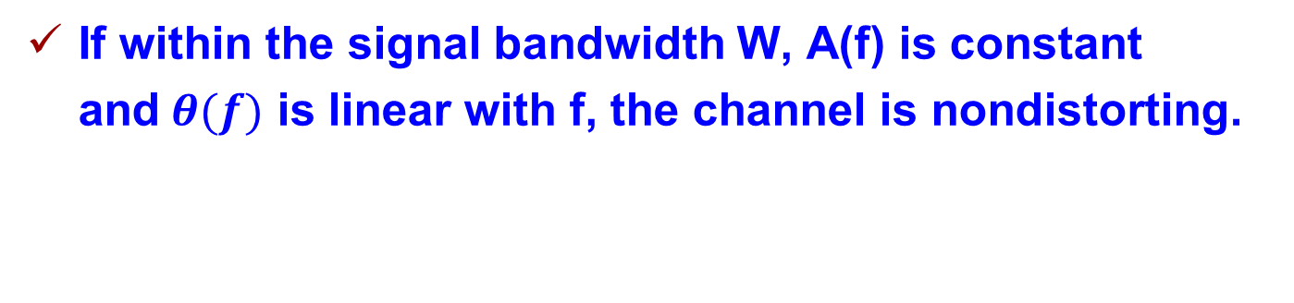
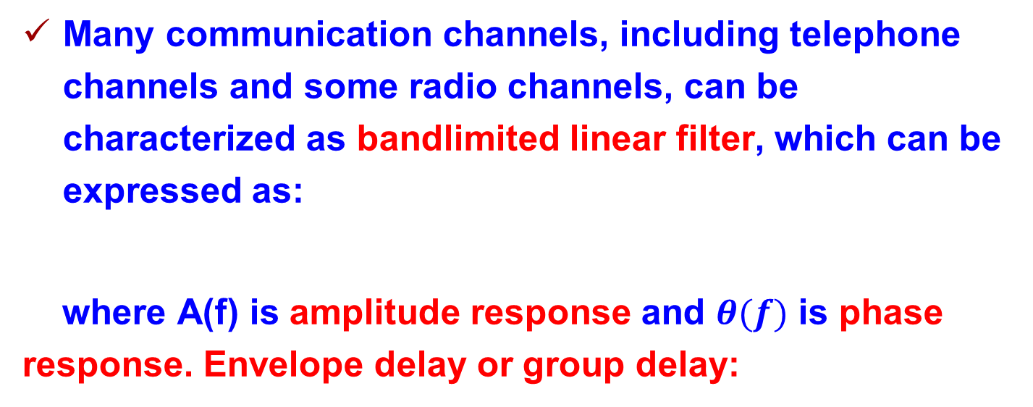
Bandlimited channels
Many communication channels, including telephone channels and some radio channels, can be characterized as bandlimited linear filter, which can be expressed as:
where A(f) is amplitude response and $θ(f)$ is phase response. Envelope delay or group delay:
If within the signal bandwidth W, A(f) is constant and$θ(f)$ is linear with f, the channel is nondistorting.
Notes:
Sin函数和举例

Slide 25
Bandlimited channels

Slide 26
Bandlimited channels
Effect of channel distortion:

Slide 27
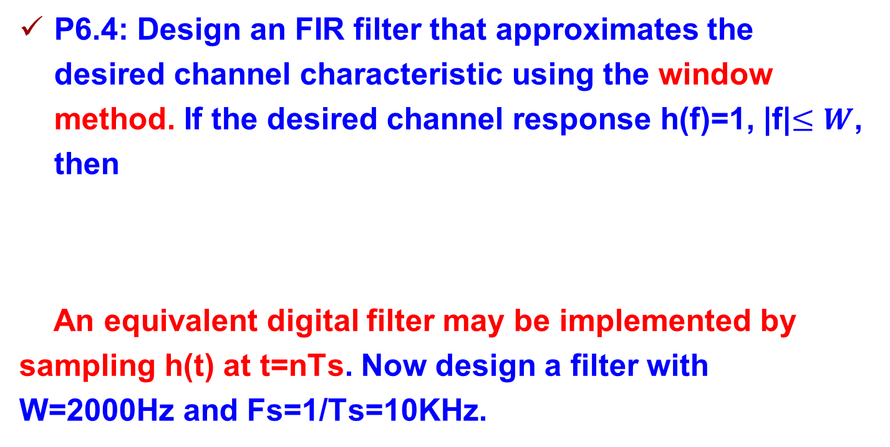
Bandlimited channels
P6.4: Design an FIR filter that approximates the desired channel characteristic using the window method. If the desired channel response h(f)=1, |f|$≤W$, then
An equivalent digital filter may be implemented by sampling h(t) at t=nTs. Now design a filter with W=2000Hz and Fs=1/Ts=10KHz.
Notes:
卷积表达式，

Slide 28
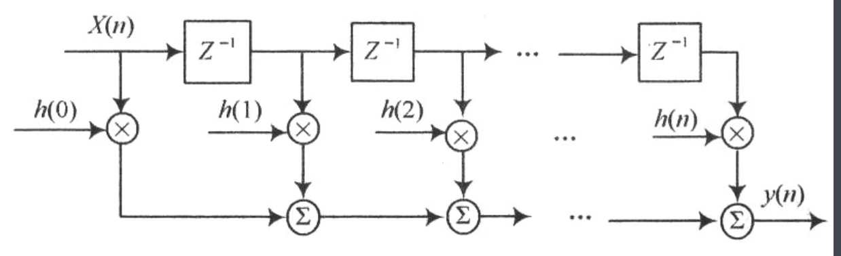

Slide 29
Bandlimited channels
P6.4: The sampled version of h(t) has infinite length. We may multiply h[n] by a window, e.g., rectangular window or some smoother window, like Hanning or Hamming window
Notes:
卷积表达式，

Slide 30
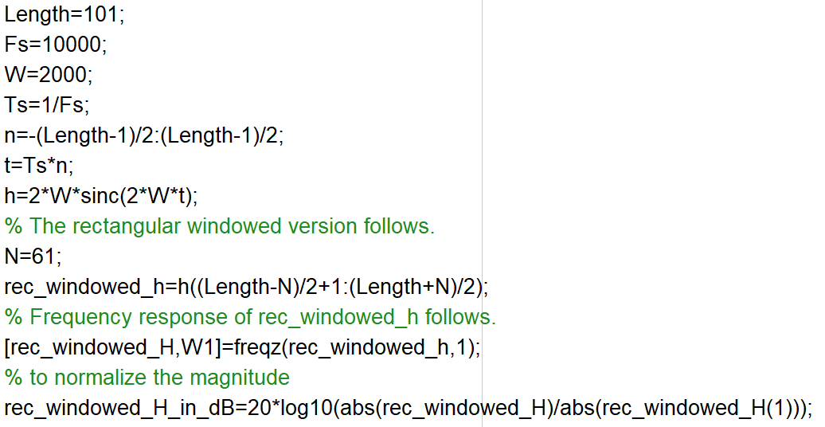
Bandlimited channels
Code:
Notes:
卷积表达式，

Slide 31
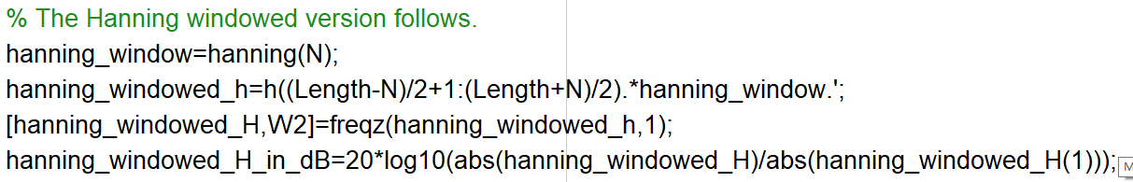
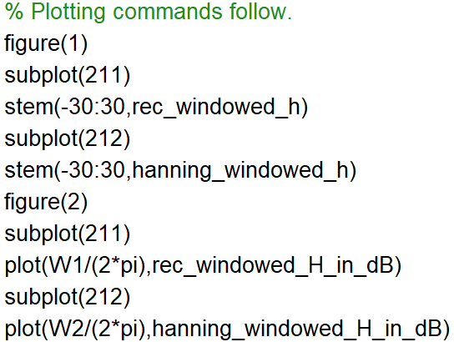
Bandlimited channels
Code:
Notes:
卷积表达式，ω=2pi*f/fs

Slide 32
Communication system under bandlimited channel
We consider the design of the transmitter and receiver filters that are suitable for a baseband bandlimited channel.
We mainly focus on the design based on transmitter and receiver filters that result in zero ISI.
The other approach is based on transmitter and receiver filters that have a specific amount of ISI. Named as partial response signal.

Slide 33
Communication system under bandlimited channel
A sufficient and necessary condition for a signal x(t) to have no ISI, i.e., (1/T is symbol rate)

Slide 34

Communication system under bandlimited channel
One of the most commonly used signals in practice has raised-cosine (RC) frequency response.
Where $α$ is roll-off factor.
x_{rc}(t)

Slide 35
Communication system under bandlimited channel
Transmitter filter
Channel
Receiver filter
Detector
In an ideal channel, the transmitter and receiver filters are jointly designed for zero ISI:
Root raised cosine (RRC) filter:

Slide 36
Communication system under bandlimited channel
Example：plot raised-cosine (RC) signal waveform and frequency spectrum for a=0，0.5，1
Step1： initialization
clear all;
close all;
Ts= 1 ;
N_sample=17;
dt = Ts/N_sample;
df = 1.0/(20.0*Ts); %20s duration
t = - 10*Ts : dt:10*Ts;
f= - 2/Ts:df :2/Ts;

Slide 37
Communication system under bandlimited channel
Step2： generate RC spectrum and waveform
alpha=[0,0.5, 1] ;
for n = 1 : length(alpha)
for k = 1 : length( f)
if abs(f(k)) > 0.5 *(1 + alpha(n))/ Ts
Xf( n,k)=0;
elseif abs( f(k) ) < 0.5 *(1 - alpha(n))/Ts
Xf(n,k)=Ts;
else
Xf (n, k )=0.5 *Ts *( 1 + cos( pi *Ts/ (alpha( n) + eps) *(abs(f ( k )) - 0.5* (1 -alpha( n)) / Ts) ) );
end
end
xt(n,:)=sinc( t/ Ts ).*(cos( alpha (n) *pi *t/Ts ))./( 1 - 4 *alpha (n) ^2 *t.^2 / Ts^2 + eps);
end

Slide 38
Communication system under bandlimited channel
Step3： plot figures
figure( 1)
plot( f,Xf);
axis([ - 1 1 0 1.2]); xlabel ('f/Ts'); ylabel('RC spectrum') ; legend('\alpha=0','\alpha=0.5','\alpha=1');
figure(2)
plot( t , xt) ;
axis([-10 10 -0.5 1.1]); xlabel('t ' ) ;ylabel (' RC waveform');
legend('\alpha=0','\alpha=0.5','\alpha=1');

